Slide 1
Instrumenting Thailand’s Coastline: Cyber-Infrastructure for Environmental and Disaster Monitoring
Michael Nekrasov
University of California, Santa Barbara

Slide 2
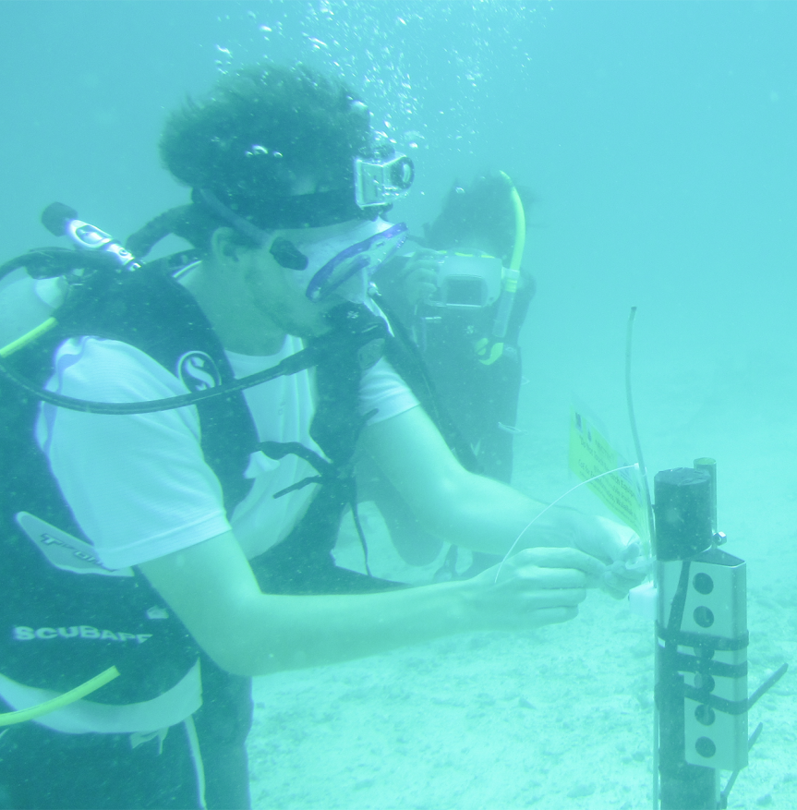
Introduction
First year graduate student from University of California Santa Barbara
Pursuing a PhD in Computer Science
Currently on a Fulbright research scholarship at Walailak University
4 years experience working on sensor networks, with multiple projects in Taiwan and Thailand

Slide 3
Research Interests
Mobile Devices as sensors for Environmental and Disaster Monitoring
Bridge the gap between computer science and biological sciences
Create technologies that are affordable and sustainable in developing regions

Slide 4
Current Projects in Thailand
Mosquito Crowd-Sensing
Aquaculture Monitoring and Early Warning Flood Detection
Coral Reef Monitoring

Slide 5
Current Projects in Thailand
Mosquito Crowd-Sensing
Aquaculture Monitoring and Early Warning Flood Detection
Coral Reef Monitoring

Slide 6
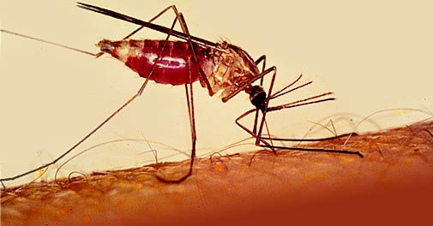
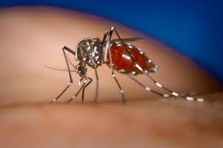
Mosquito Crowd-Sensing
In collaboration with Siriwan Wongkoon
Walailak University has many outreach programs with local high schools.
Part of an effort to integrate real-world science into local high school curriculum
Students learn biology and field work, while contributing real scientific data

Slide 7
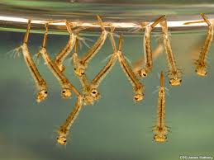
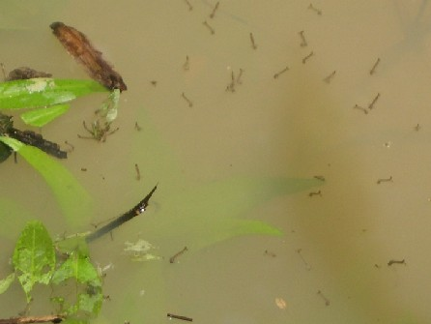
Mosquito Crowd-Sensing
In collaboration with Siriwan Wongkoon
Students:
Learn to identify mosquito species and how they reproduce and carry disease
Go out and identify mosquitos, and water canisters that can facilitate mosquito reproduction
Record this data into a central database for use by biologists

Slide 8
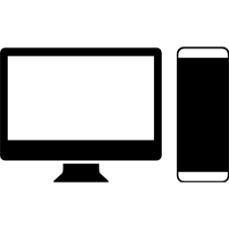

Mosquito Crowd-Sensing
In collaboration with Siriwan Wongkoon
My work expanded on this system to create a mobile application for in field data entry
The application simplified the data entry process and allows in field data entry (where internet is available)
The application is available as both a mobile website (for any mobile OS) and as an Android application

Slide 9
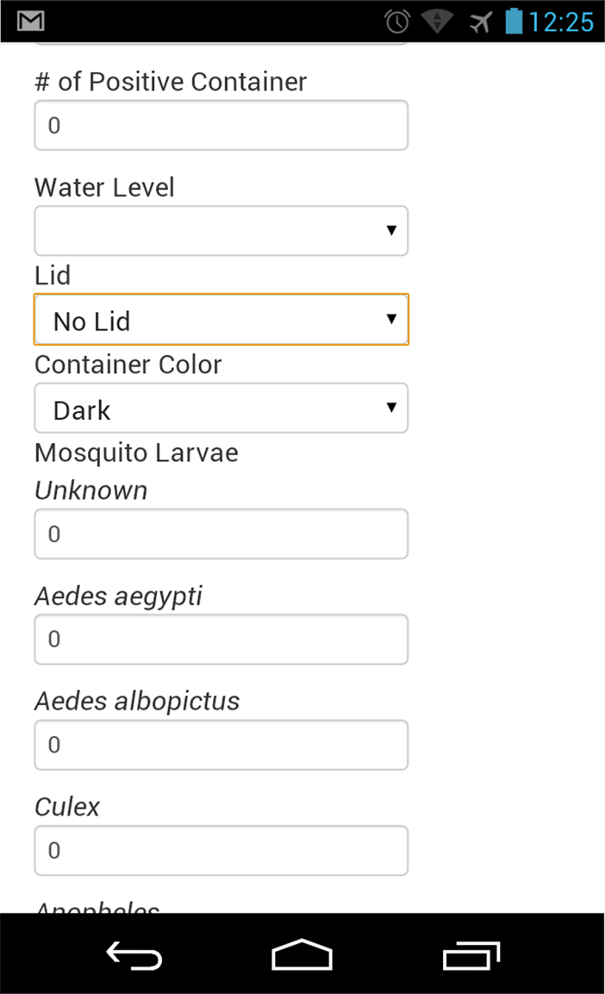
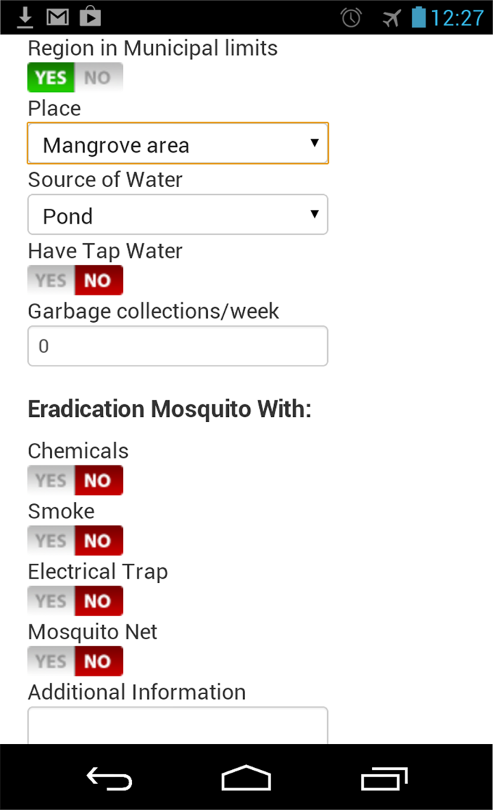

Slide 10
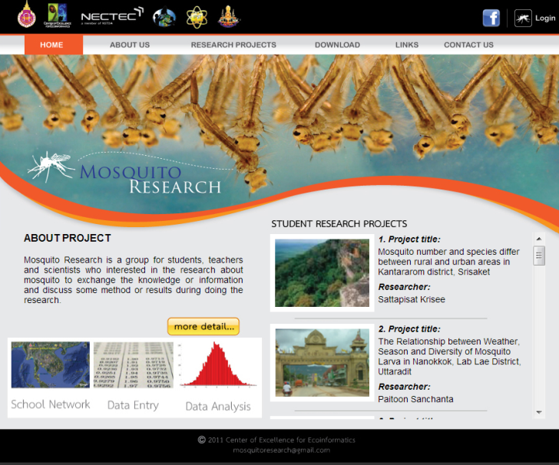
Mosquito Crowd-Sensing
In collaboration with Siriwan Wongkoon
This application is available and can be a part of any school curriculum
The data is also made available and can be used for the study of diseases like Dengue Fever and Malaria which use mosquitos as vectors for infection
http://twibl.org/mosquito/

Slide 11
Current Projects in Thailand
Mosquito Crowd-Sensing
Aquaculture Monitoring and Early Warning Flood Detection
Coral Reef Monitoring

Slide 12
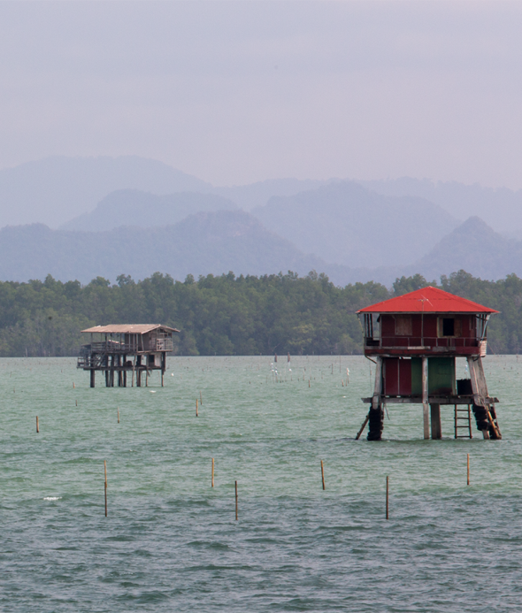
Aquaculture Monitoring & Early Warning Flood Detection
In collaboration with Sirilak Chumkiew
Bandon Bay, Surathani province is home to mussel, cockle, oyster, and shrimp farmers.
Severe rainfall causes an influx of freshwater and sediment into the bay.
This causes massive damage to the aquaculture industry.

Slide 13
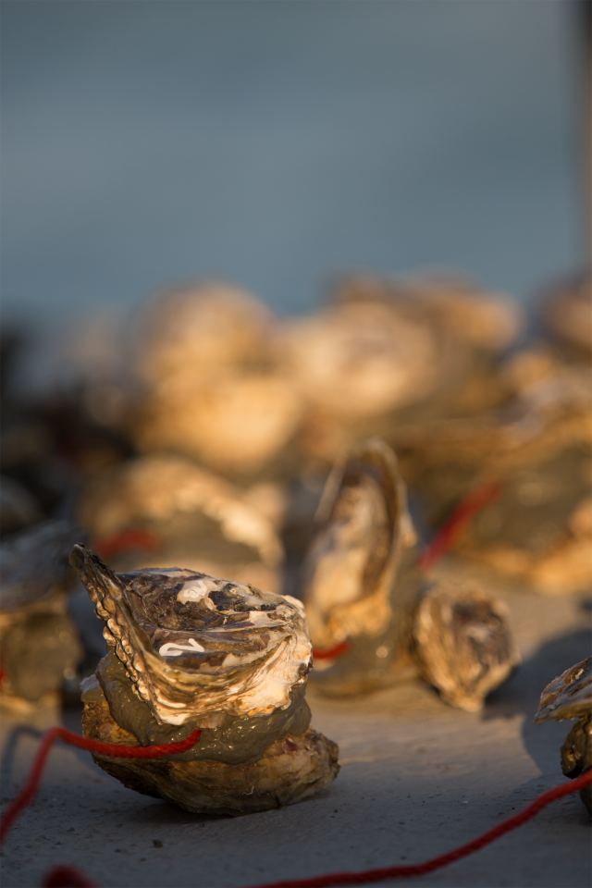
Aquaculture Monitoring & Early Warning Flood Detection
In collaboration with Sirilak Chumkiew
Goal: Monitor water quality in the bay and detect potential flooding events
Use a series of weather stations and underwater sensors monitoring
Salinity
Temperature
Pressure
Turbidity
Dissolved oxygen.
Analyze this data in real-time at the site

Slide 14
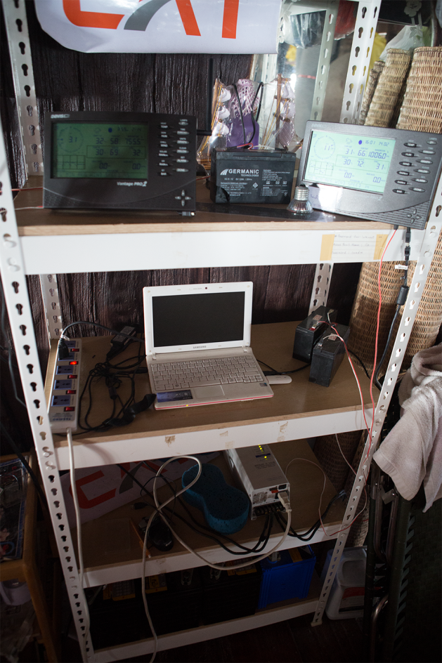
Aquaculture Monitoring & Early Warning Flood Detection
In collaboration with Sirilak Chumkiew
Progress so far
Weather station deployed at the bay
Solar Panels for power
Cellular for data
Netbook for computing
Still waiting on water sensors
Currently performing monthly water quality sampling

Slide 15
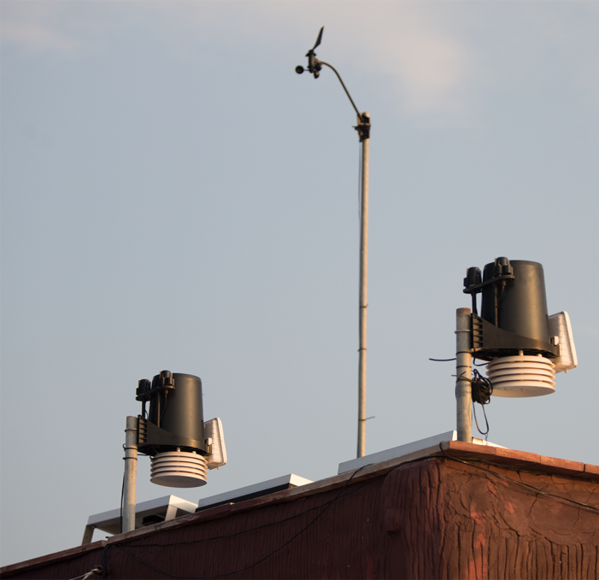
Aquaculture Monitoring & Early Warning Flood Detection
In collaboration with Sirilak Chumkiew
Current work
Solar cells not providing sufficient power for stable system
Planning on deploying Raspberry Pi for computation & communication
Interested in also looking at UCSD Android sensor pod as alternative

Slide 16
Current Projects in Thailand
Mosquito Crowd-Sensing
Aquaculture Monitoring and Early Warning Flood Detection
Coral Reef Monitoring

Slide 17
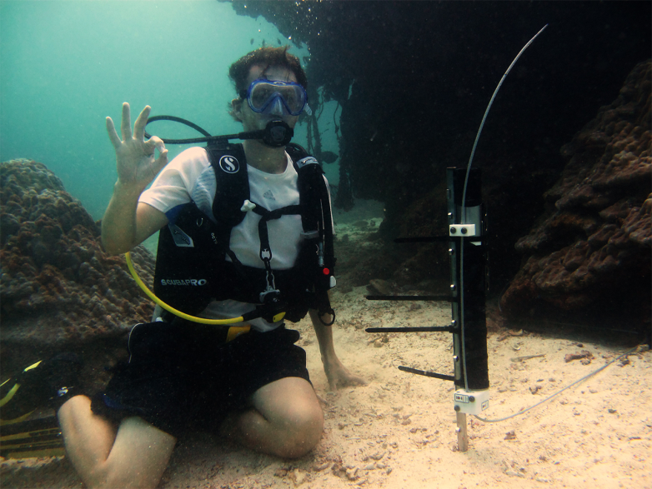
Coral Reef Monitoring
In collaboration with Walailak COE
Coral reef observatory at Racha Yai, Phuket
Original deployment was a product of the PRAGMA 18 workshop
Collaboration between:
Australian Institute of Marine Science
COE at Walailak
University of California, San Diego

Slide 18
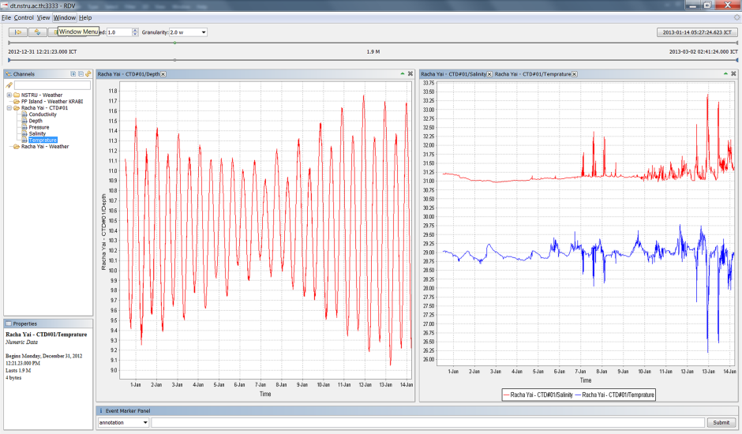
Coral Reef Monitoring
In collaboration with Walailak COE
The observatory has been streaming real-time data since 2010
Utilized for a variety of research projects at Walailak
Data and results publicized and used in some secondary school curriculums
Original collaboration has helped provide the start for further funding and expansion

Slide 19
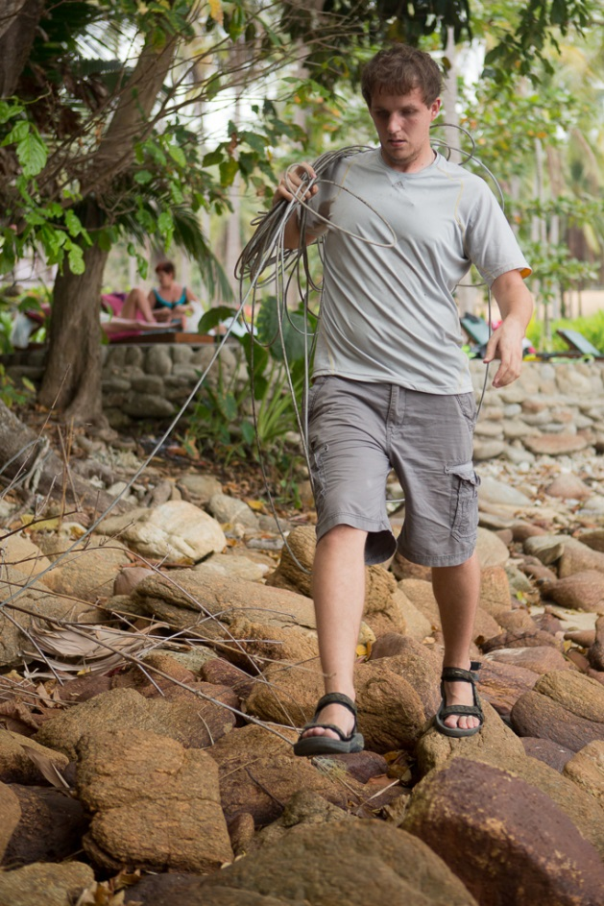
Coral Reef Monitoring
In collaboration with Walailak COE
System has been operational for 2.5 years in spite of power failure, network disruptions, and storms.
But in February we did need to replace cable after a shipwreck tore the existing one.

Slide 20
Coral Reef Monitoring
In collaboration with Walailak COE
New Project:
Expand coral reef observatory at Racha Yai, Phuket to include an additional site on far side of the island
Will require wireless communication and independent power.
Finished initial survey in February, now in logistical planning stages

Slide 21
Common Elements
Environmental and disaster monitoring can utilize parts of the same infrastructure
Environmental monitoring, especially in developing regions requires systems that are affordable and can recover in spite of harsh environmental factors.
‘Online’ sensors provide a great asset not just for research but for education and public engagement

Slide 22





Acknowledgements
Fulbright for funding my current study
Walailak University, for being such gracious hosts
Graduate Advisor Elizabeth Belding
Undergraduate Advisor Tony Fountain
National Science Foundation for multiple sources of funding for my research

Slide 23
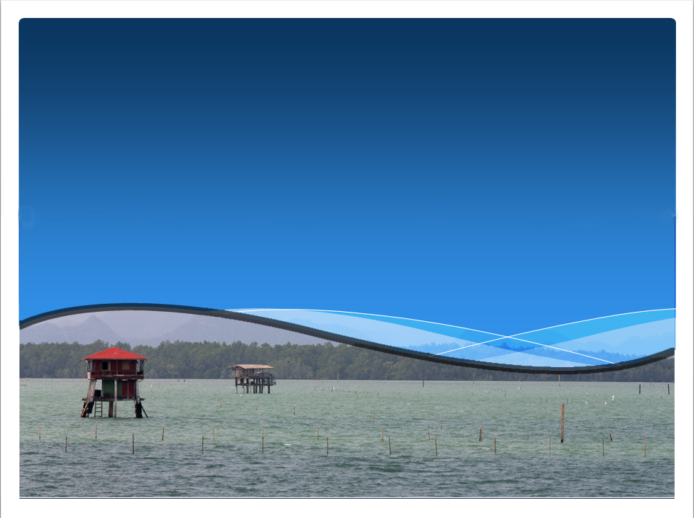
Questions/ Comments/ Idea?

